Slide 1

SHEIN
THE SECRETIVE CHINESE BRAND DRESSING GEN Z

Slide 2

Team

Slide 3
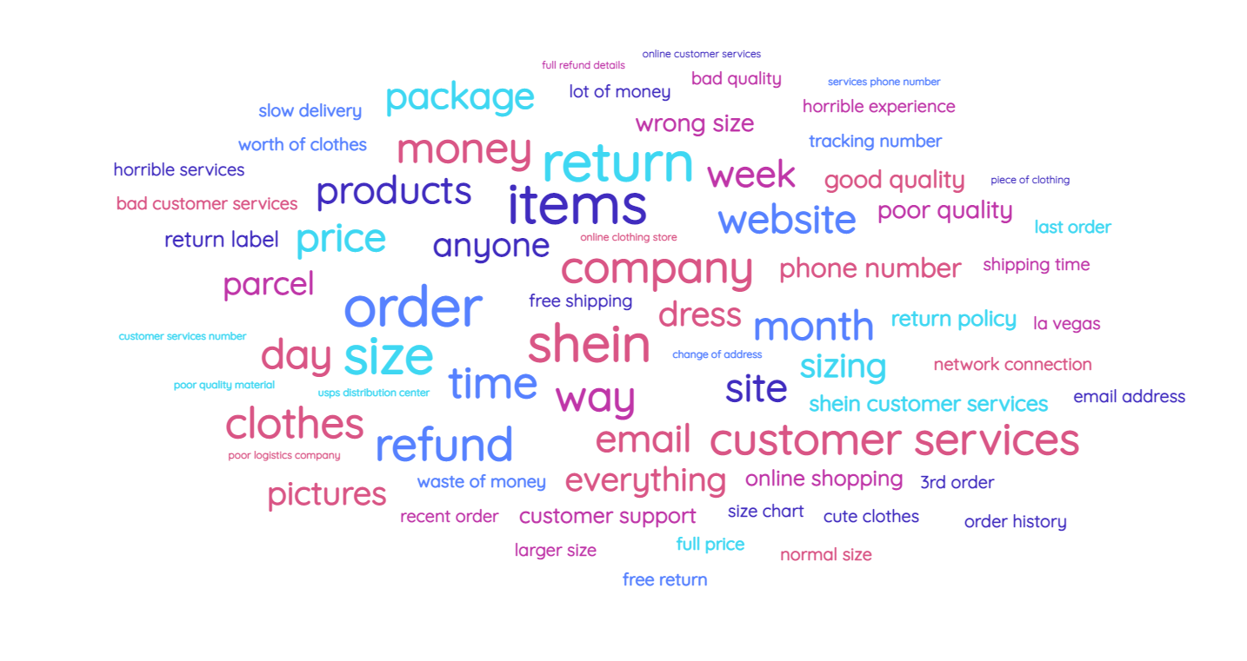
SHEIN Customer Review Word Cloud

Slide 4





Problem Descriptions
Frustrating Returns
Flummoxing
Size Charts
Fictional Customer Support
Customers are finding it hard to place returns, having packages lost and not getting refunds, having trouble with return labels.
Every country/Region have very different size charts. Particularly for Clothing industry having a proper size chart has always been a challenge.
The customer care numbers have not been setup/are unreachable in most locations. If the customer care is reachable, the automated service repeats the same recorded message making it difficult for the customers.

Slide 5


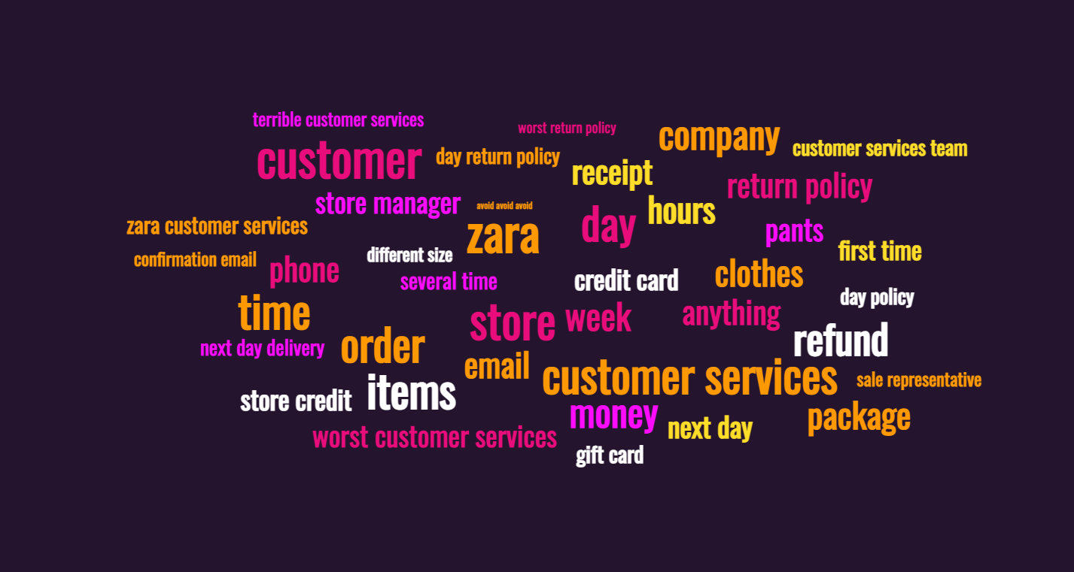
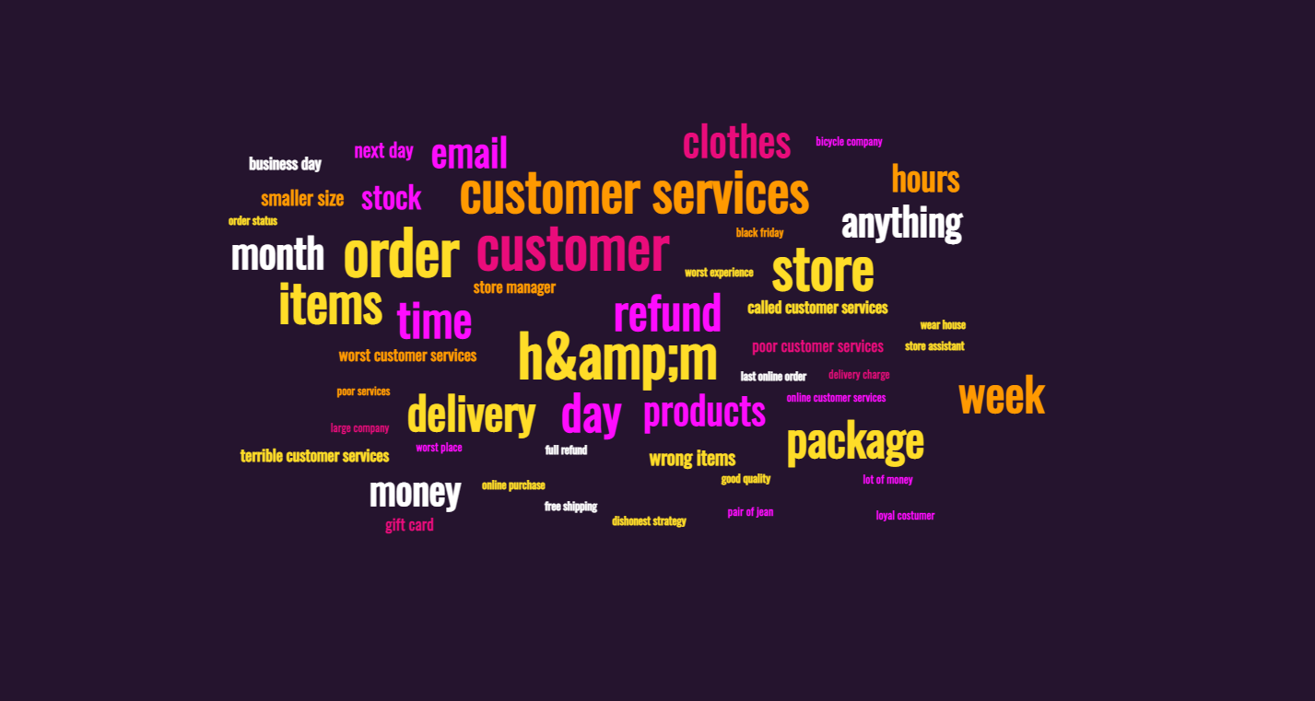
Competitor Customer Review Analysis

Slide 6
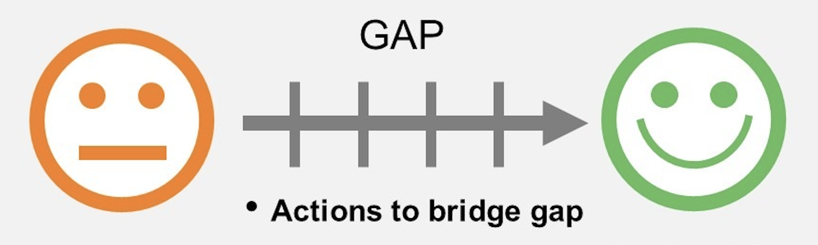
Gap Analysis
Frustrating Returns
Fortifying Returns
Fictional Customer Support
Factual Customer Support
Facilitating Size Recommendations
Flummoxing Size Charts

Slide 7
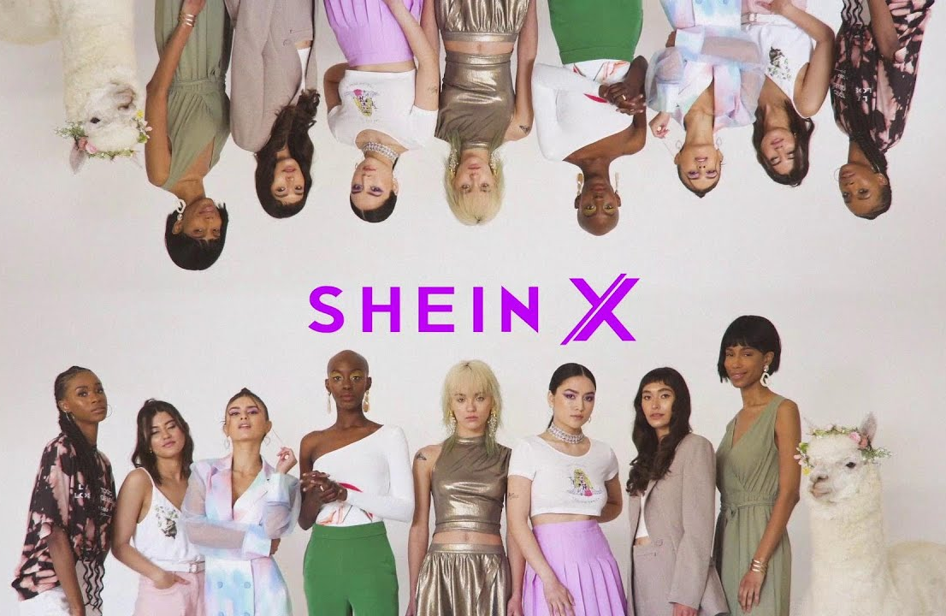

Why Now?
Becoming a market disruptor in the fast fashion industry could be a “Right place at the right time” kind of thing.
The pandemic was that moment for Shein, when a huge chunk of the population shifted from traditional shopping to e-Retail. During the time of 2019-2021, shein has seen an increase in revenue from $3.15 Billion to $15.7 Billion.
Remaining a market disruptor is going to be a challenge. To cater to that thought, it is important that Shein fixes their current issues to maintain its position as well as gain customer faith while building the Brand Value.

Slide 8

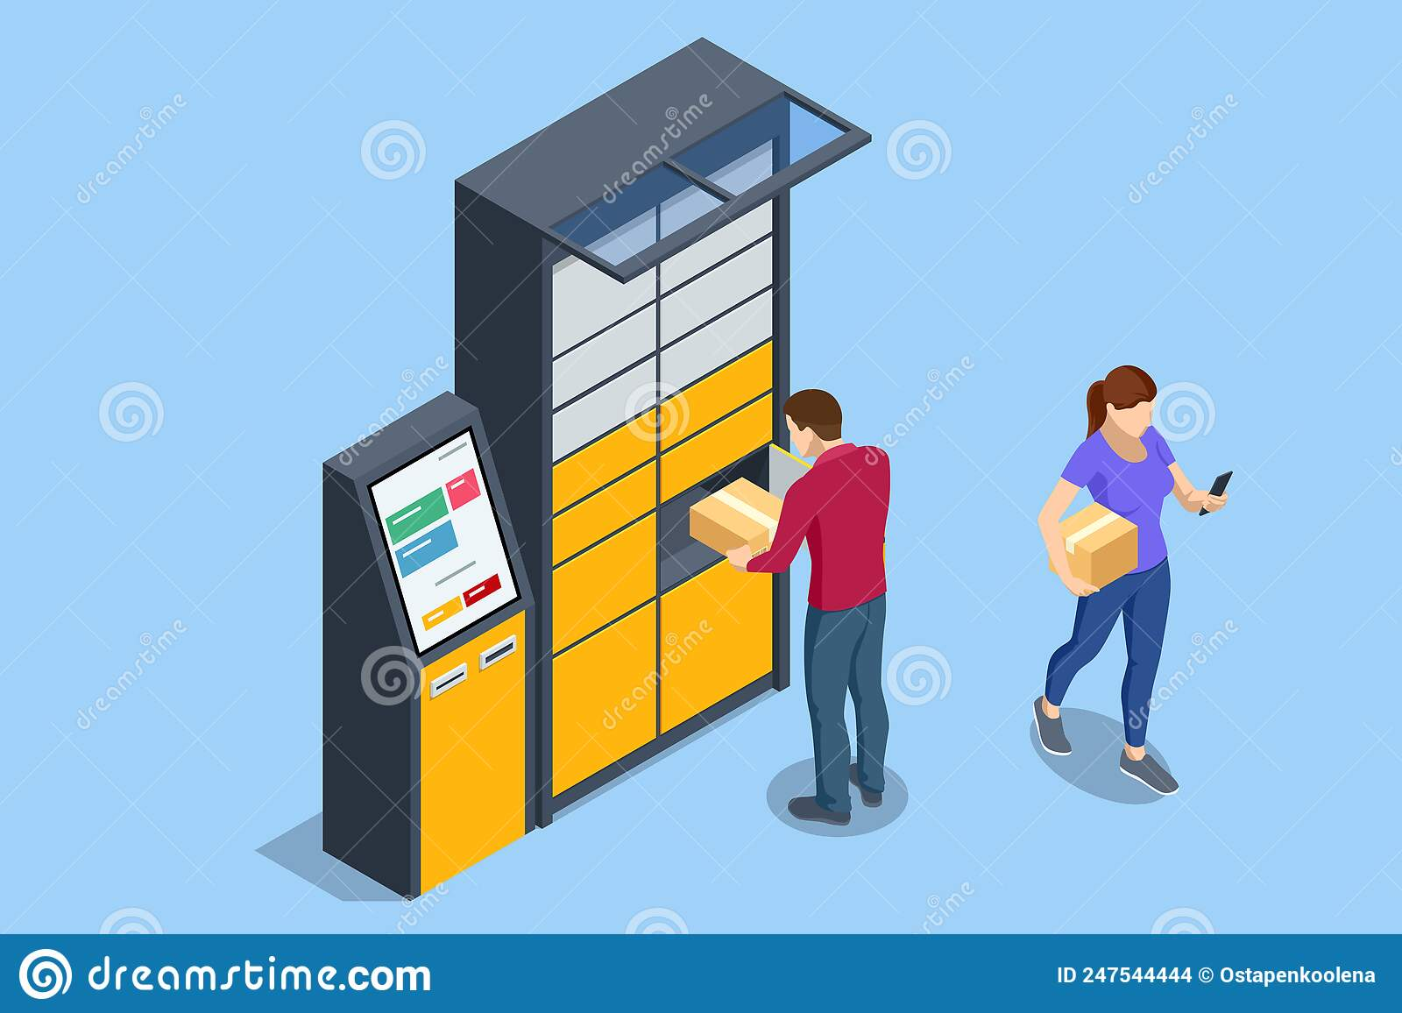


Proposed Solution Descriptions
Contact Less Return Lockers:
Revamped Customer Service:
Personalized Size Recommendations:
Have Contact-less return lockers installed in various locations.
These return lockers will have a scan pad to scan the return labels.
A designated locker assigned to the customer will pop open for them to drop off their return package.
Use NLP to automate and enhance the existing customer support engine (CSE).
Enhanced CSE can handle multi-minute conversations and log complaints properly.
We also propose to integrate this CSE with common communication platforms like Messenger, whatsApp, etc,.
Use AI and ML models to make personalized size recommendations.
For existing users, recommendations will be made based on their purchase history.
For new users, recommendations will be made based on the generic country/city standards.
Notes:
(These don’t have designer IDs since they were based off the default master slides already in the deck.

Slide 9


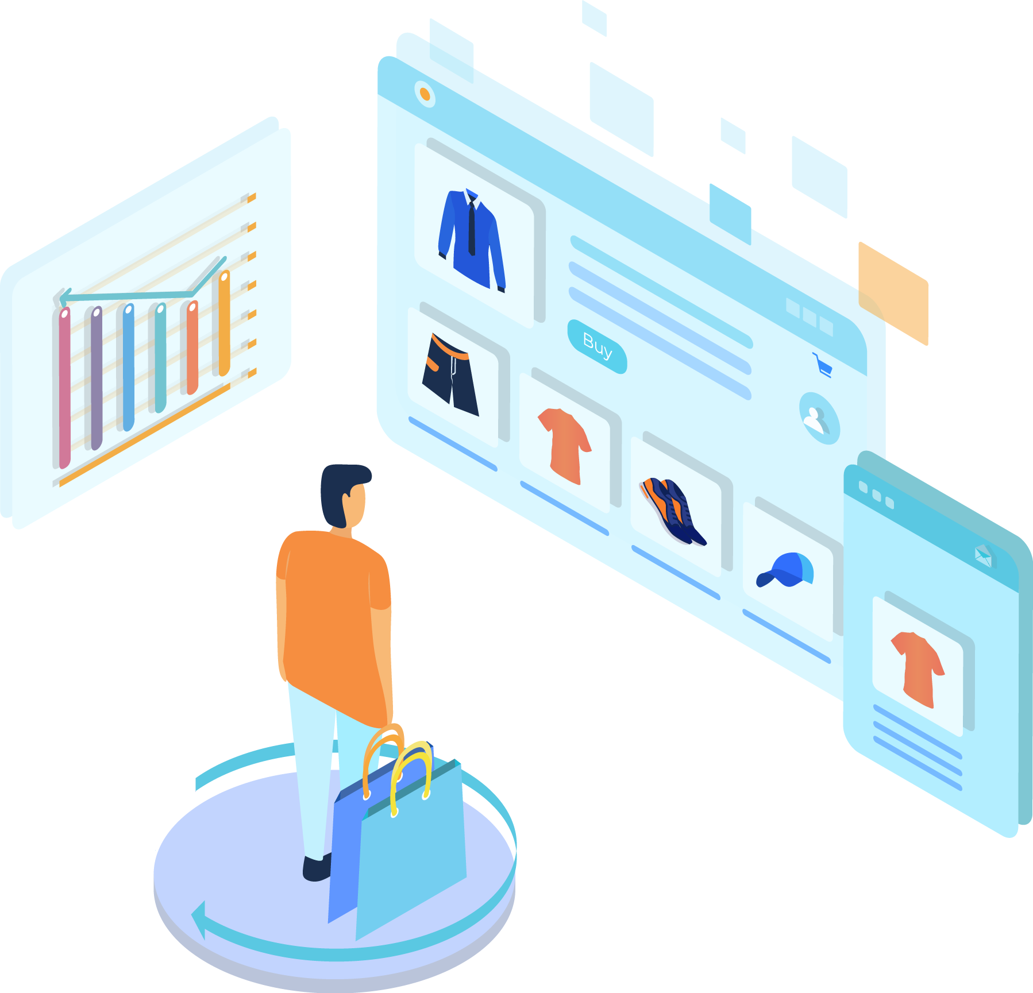
Added Advantage
Contact Less Return Lockers:
Revamped Customer Service:
Personalized Size Recommendations:
Ease the tedious return process for customers.
Help regain the lost reputation and increase customer faith.
Increase customer retention rate.
Increase efficiency in recording customer issues.
Improve the customers shopping experience.
Reduce the dependency on manual customer support personnel.
Provide us an edge over our competitors who currently do not have this feature.
Ease the shopping experience for customers.
Increase in customer satisfaction.
Notes:
(These don’t have designer IDs since they were based off the default master slides already in the deck.

Slide 10




Digital Capability
System Capability
Process Capability
Organizational Capability
AI, ML and NLP implementation for improvising chatbot conversational capabilities.
Recommendation system for nearest return store location after generation of designated return barcodes.
Product selection, Return process modification, Sizing recommendation, User engagement improvisation
Finance Planning,Resource allocation,security plugins deployment,Hiring the talent, Training the employees,Risk and mitigation

Slide 11

Customer journey map
Scenario : Myra is a instagram influencer and want to buy fast fashion clothes for increasing her followers
Expectations:
Find apparels which are in trend in the least time
Have a support that is available anytime incase she gets into trouble while shopping
Easy order/returns and size recommendation service availability
Consider
Explore
Purchase
Service
Loyalty
Visits the website after seeing a social media campaign
Browses through the wide variety of apparel & creates an account to add the selected items to cart.
Proceeds to complete the purchase by providing payment details.
Felt easy and comfortable while shopping.
Made hassle free returns if necessary after receiving the delivery.
Rates the order received, and uses her refund or credit voucher for a subsequent purchase.

Slide 12

Necessary Resources
Human Resources :Team of 15 people including Project Manager, Software developers(ML, AI, NLP, Web Programming), Testers and Support personnel.
Financial planning Team (to strategically map an appropriate budget)
Dedicated Customer Service Team : A team of 20 personnel per country of operations who would be attending to the tickets raised using the automated customer service system & also monitor the calls to jump in when needed.
Infrastructure (Hardware & Software)
External Resources :
FedEx -> Tie up with FedEx to ship the return packages back to the warehouse from different locations.
Local Vendors from different locations to build & install the lockers.
Malls -> tie-up with malls around all major cities to install & maintain our return lockers.

Slide 13

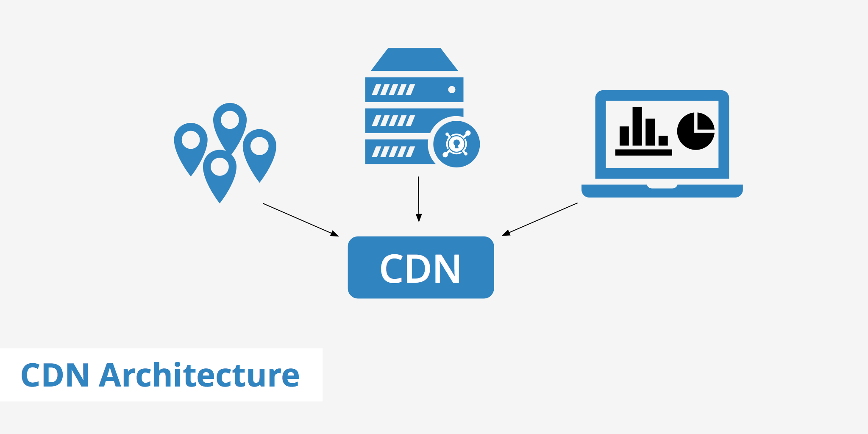









System Architecture
Fetch static data and pages
App Layer
External Payment Service
Multi-Factor Authentication
Business Logic
Search Functionality
Fetch dynamic data based on user logged in
Payment service
External Services
Secured locker
Storage Layer
Internal Services
[Size]
Relational DB on Disk
Redis in-memory storage
ChatBot Service
Recommendation Service
Notes:
All the other layers like application layer and storage layer will not change. Only the internal services will have changes incorporated such as the chatbot service is improvised and is integrated with whatsapp and messenger.The size recommendation will be integrated within the internal services. The external services like vendors and mall facilities will work with Shein to install the secured return lockers in the mall.

Slide 14
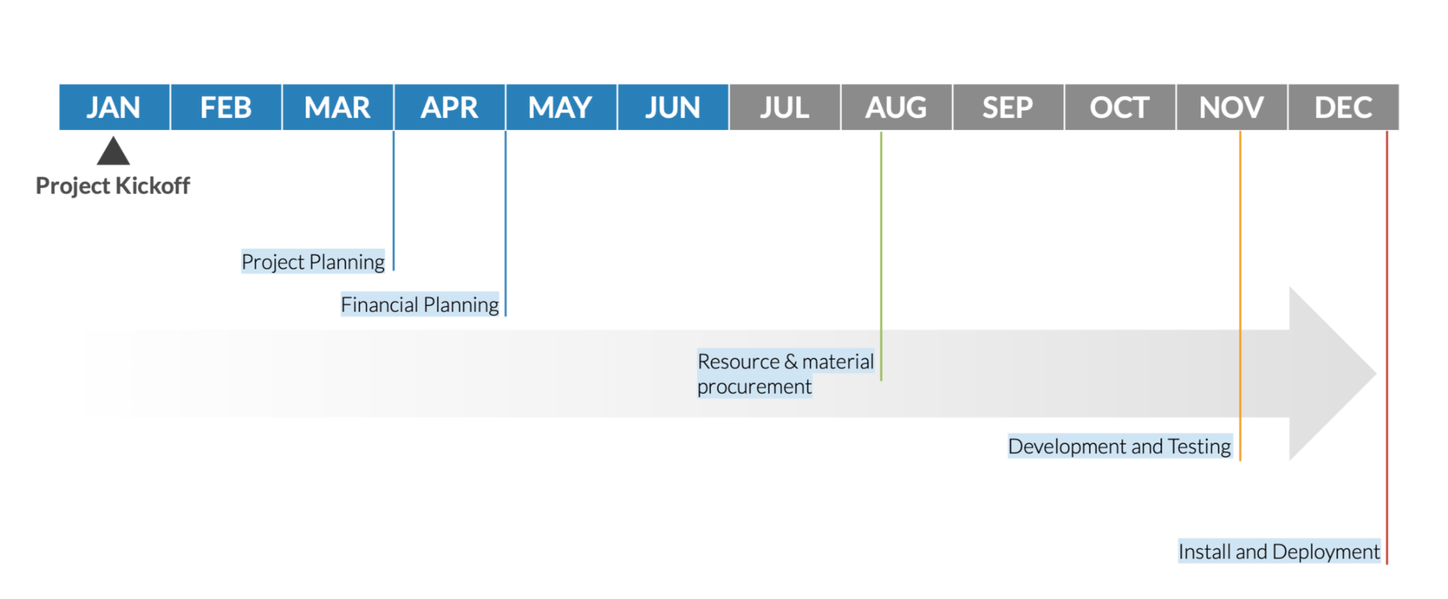
Project Timeline

Slide 15


Project Roadmap
Jan | Feb | Mar | Apr | May | Jun | Jul | Aug | Sep | Oct | Nov | Dec
Project activities will be distributed and executed in multiple sprints(Each spanning 4 to 5 weeks) to drive maximum efficiencies in the tasks
Project Kickoff
Project Planning
Project Scope
Tool Analysis
Team Building
Financial Planning
Resource and Material Procurement
Budget for material
Budget for resources
Budget for tools and software
Local vendors for lockers
FedEx as an external resource
Customer service team
Facilities
Development and Testing
Performance Testing
Canary Testing in East USA
Installation and Deployment
Final Release
Support team training
Installation of lockers
Deployment of size recommendations on website and app

Slide 16
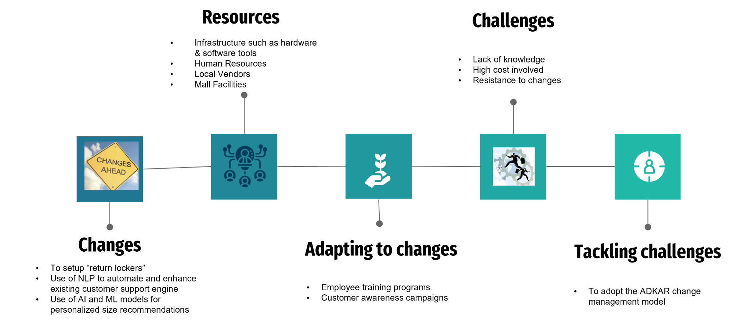
Change Management Process
Notes:
In the change management process - changes would include the set up of “return lockers”, the use of NLP to automate and enhanced existing customer support engine and also the use of AI and ML models for personalized size recommendations. The resources required for this change would include infrastructure such as hardware and software tools, human resources who are proficient in ML, NLP, local vendors who can build secured lockers as well as Mall facilities. In order to adapt to these changes, we need to have employee training programs so that employees are informed and trained with new internal process and software changes. In addition to this we will also require to have customer awareness campaigns to inform them on the return lockers policy so that customers are well aware of the changes. Some of the challenges with regards to these changes would include lack of knowledge in terms of usage of new technologies, high cost involvement when setting up return lockers in mall facilities and resistance to changes as employees have to relearn and adopt to new changes. Next slide

Slide 17
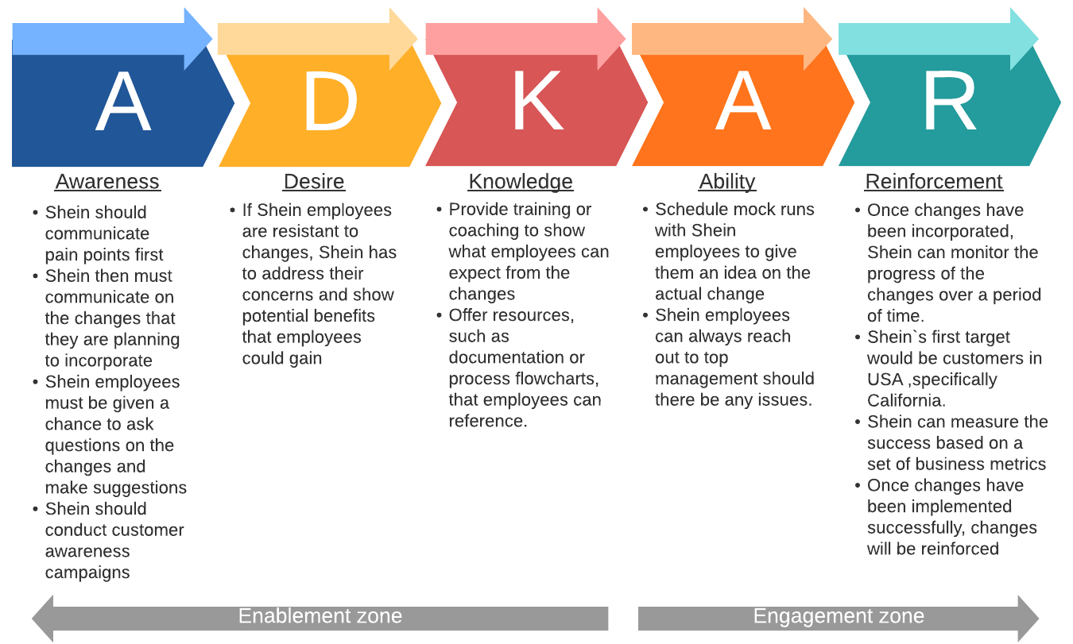
Change Management Model - ADKAR
Notes:
ADKAR model can be adopted by Shein to tackle challenges with respect to implementation of changes. What shein could do is to announce changes to employees ahead of time and prepare them well for the changes. When explaining on the changes, the management should communicate the pain points that they currently facing, rationale behind implementing the changes and potential benefits that they can gain from the change. From this, employees can be given opportunities to ask questions and make suggestions to the changes. From there, employees can be trained to adopt to the changes and schedule practice runs before change is implemented. Once changes are implemented, Shein can reinforce the change by monitoring the change over time and use positive feedback to encourage employees to keep up with the new process. Next slide

Slide 18
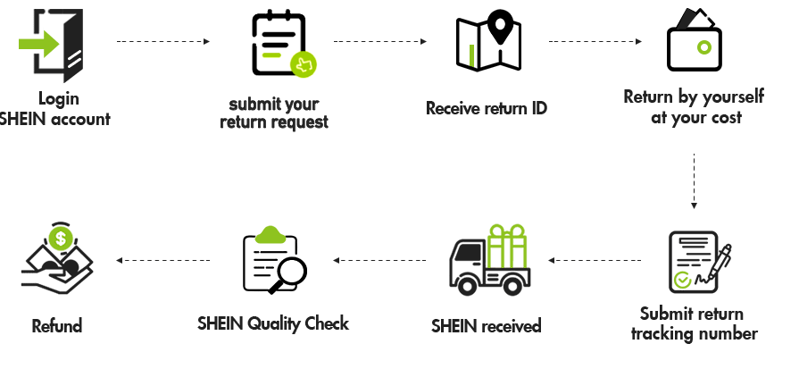
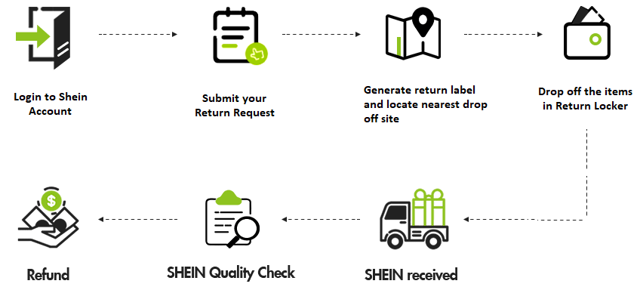
Current Vs Future State (Returns)
Current State
Future State
Notes:
This shows the comparison of Shein`s current state and Future state for Returns. As we can see from the current state, customer requires to receive return ID after submitting return request and then customers have to return the clothing item by themselves at their own cost to get the refund. In future state, with the secured return locker, there would be a return label generated and customers can locate nearest drop-off site to drop of their items in Return locker. Next slide please
Reference: https://m.shein.com/ar-en/Return-Policy-a-281.html

Slide 19
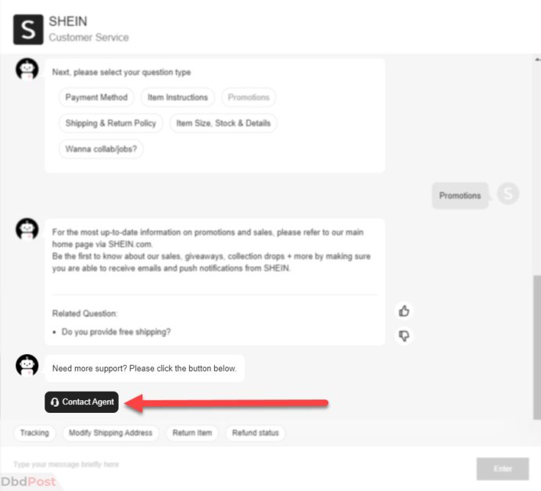

Current Vs Future State (Customer Support)
Current State
Future State
Notes:
Next would be the comparison of Shein`s current state and future state for customer support. As shown in the current state, even-though the chatbot is available, the chatbot answers general questions/issues but for specific questions/issues, the chatbot just repeats the same recorded message asking customers to contact agent directly where agent is sometimes unreachable or even worse, the customer care support is not setup making it difficult for the customers. For future state, with the improvisation of chatbot using NLP and ML, the chatbot can handle multi-minute conversations and furthermore, there will be integration of whatsapp and messenger services with the chatbot. Next slide
Reference: https://dbdpost.com/how-to-contact-shein-customer-service/

Slide 20
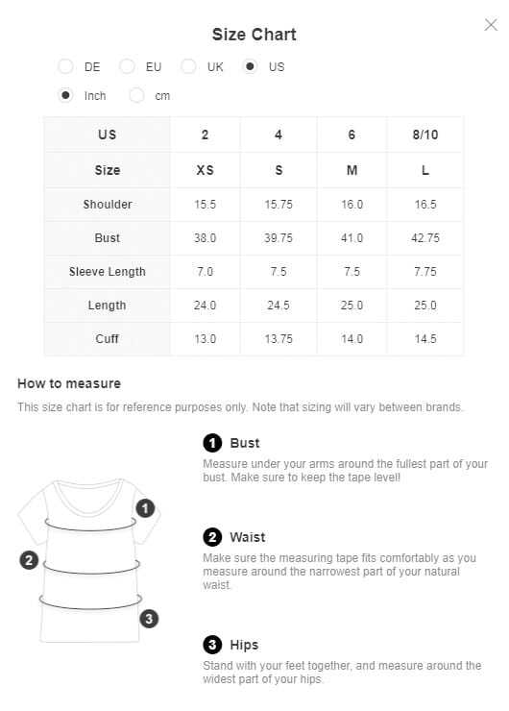
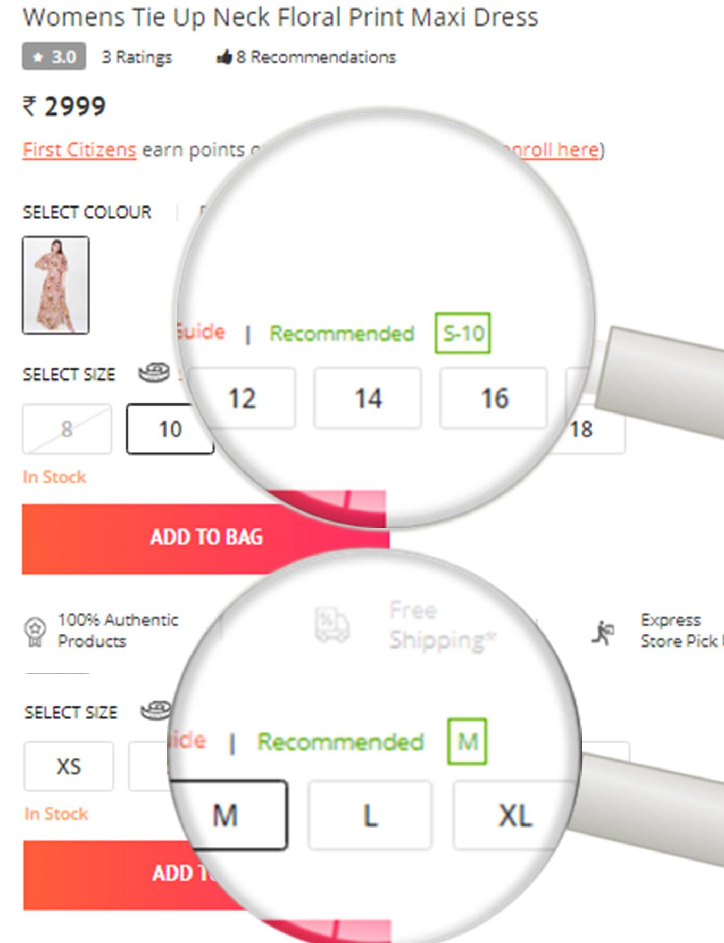
Current Vs Future State (Personalized Recommendations)
Current State
Future State
Notes:
The above is a comparison of Shein`s current state and Future state for personalized recommendation. As shown in the current state, the size chart is currently available for Shein. As mentioned earlier every country/region has different size charts and standards so this is an issue with many clothing apparels when it comes to perfect size charts. For future state, we recommend incorporating size recommendation feature using AI and ML models to make personalized size recommendations based on the User’s purchase history. For new user we can make the recommendations based on the generic country/city standards. Next slide

Slide 21


Risk & Mitigation
Risk
Mitigation
Security and surveillance of lockers.
Chatbots are efficient but not effective, i.e., they do not understand human context.
Making personalized size recommendations based on the purchase history will always have an issue of accuracy. Ex: changing data(for existing Customers) or no data(for new customers)
Increased risk of Security Breach with new integrations (Messenger/WhatsApp) leading to theft of customer data.
Locating the return lockers in relatively secured locations with surveillance like Malls.
Monitor conversations for Key words and notify support personnel when there is a necessity for them to take over based on a risk metric (Low/Moderate/High).
Have a backup system to allow new or existing users to enter the dimensions and we would make size recommendations accordingly.
Setting up secured network firewalls at the backend to avoid external breach.

Slide 22

Regulatory Steps
Provide the full supply chain disclosures - outlining the steps it is taking to prevent modern slavery in its supply chain.
Rivals like - H&M, Zara, publish detailed information about their supply chain and code of conduct on their websites.
GDPR - the aim is to ensure individual’s data in stored with consent, for a specific purpose.
Achieving GDPR compliance:
Raise awareness enterprise-wide: Create GDPR awareness across all departments of the organization, and create a culture of data security.
Designate a DPO (Data Protection Officer)
Purpose limitation: A principle that data collected for one specific purpose should not be used for a new, incompatible purpose.
Notes:
https://ico.org.uk/for-organisations/guide-to-data-protection/guide-to-the-general-data-protection-regulation-gdpr/principles/
https://www.reuters.com/business/retail-consumer/exclusive-chinese-retailer-shein-lacks-disclosures-made-false-statements-about-2021-08-06/

Slide 23





Potential Benefits
30% enhanced customer experience & satisfaction
35% Increase in successfully resolving issues
75% reduced customer support hours
25% Increased Brand value & reputation
40% Increased profitability & Sales
Notes:
The potential benefits from the changes implemented would be firstly enhanced customer experience & satisfaction as customers will get to have contact-free return process with the return lockers implemented in the mall and lenient return policies. With chatbots being improvised, there will be an increased % of issues of being resolved as queries from customers will be answered promptly by the chatbot. With the personalized recommendation size integrated into software, the system will guide customers and give a fair idea on the sizing in which no other current market competitors provide such as personalized size recommendations on their website or mobile app and hence this will help in increasing brand value and reputation of Shein. Last but not least, Shein will have increased profitability and sales through enhanced customer satisfaction and increased brand value and reputation.
Now I will pass on the presentation to Sneha

Slide 24

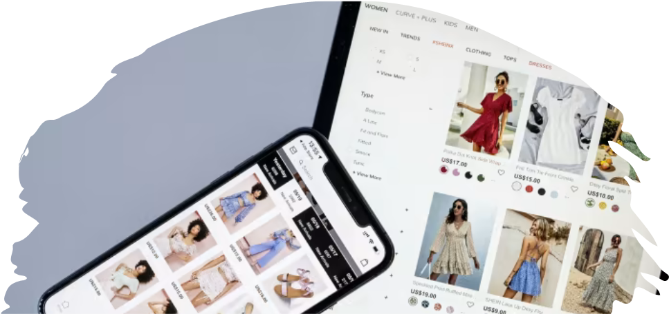
Thank You!

Slide 25
Back up Slides

Slide 26
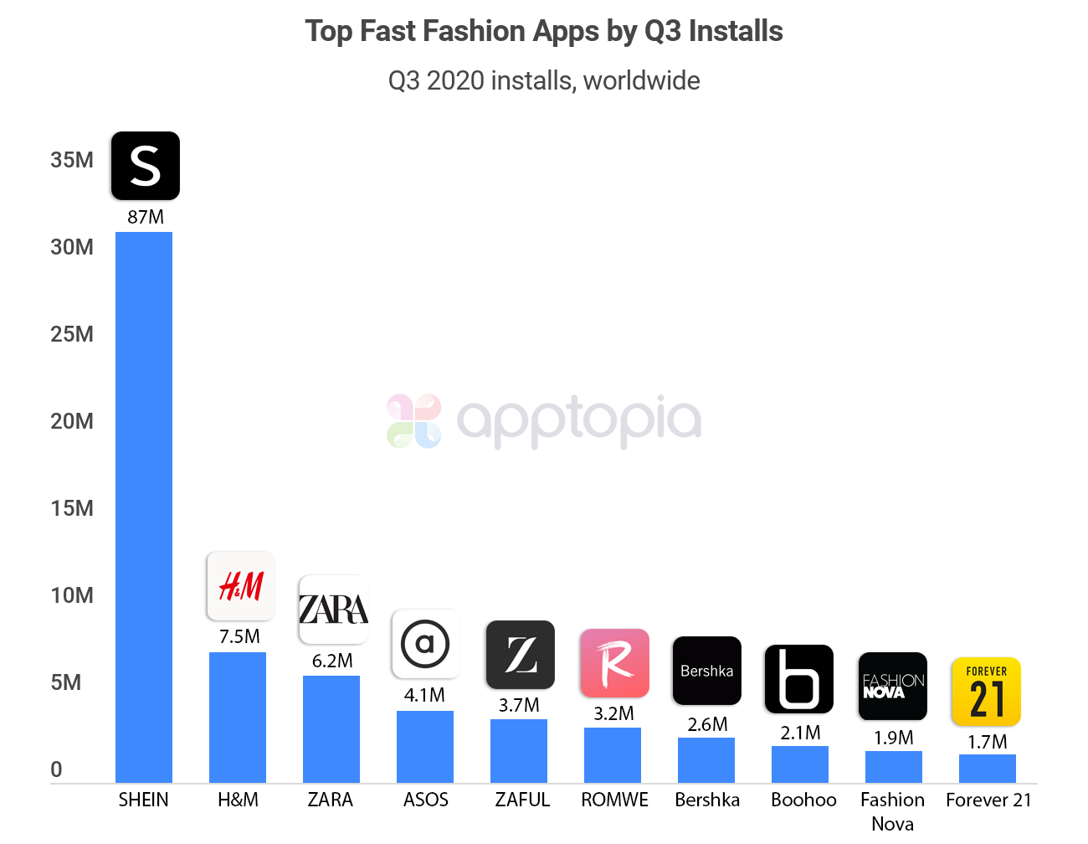
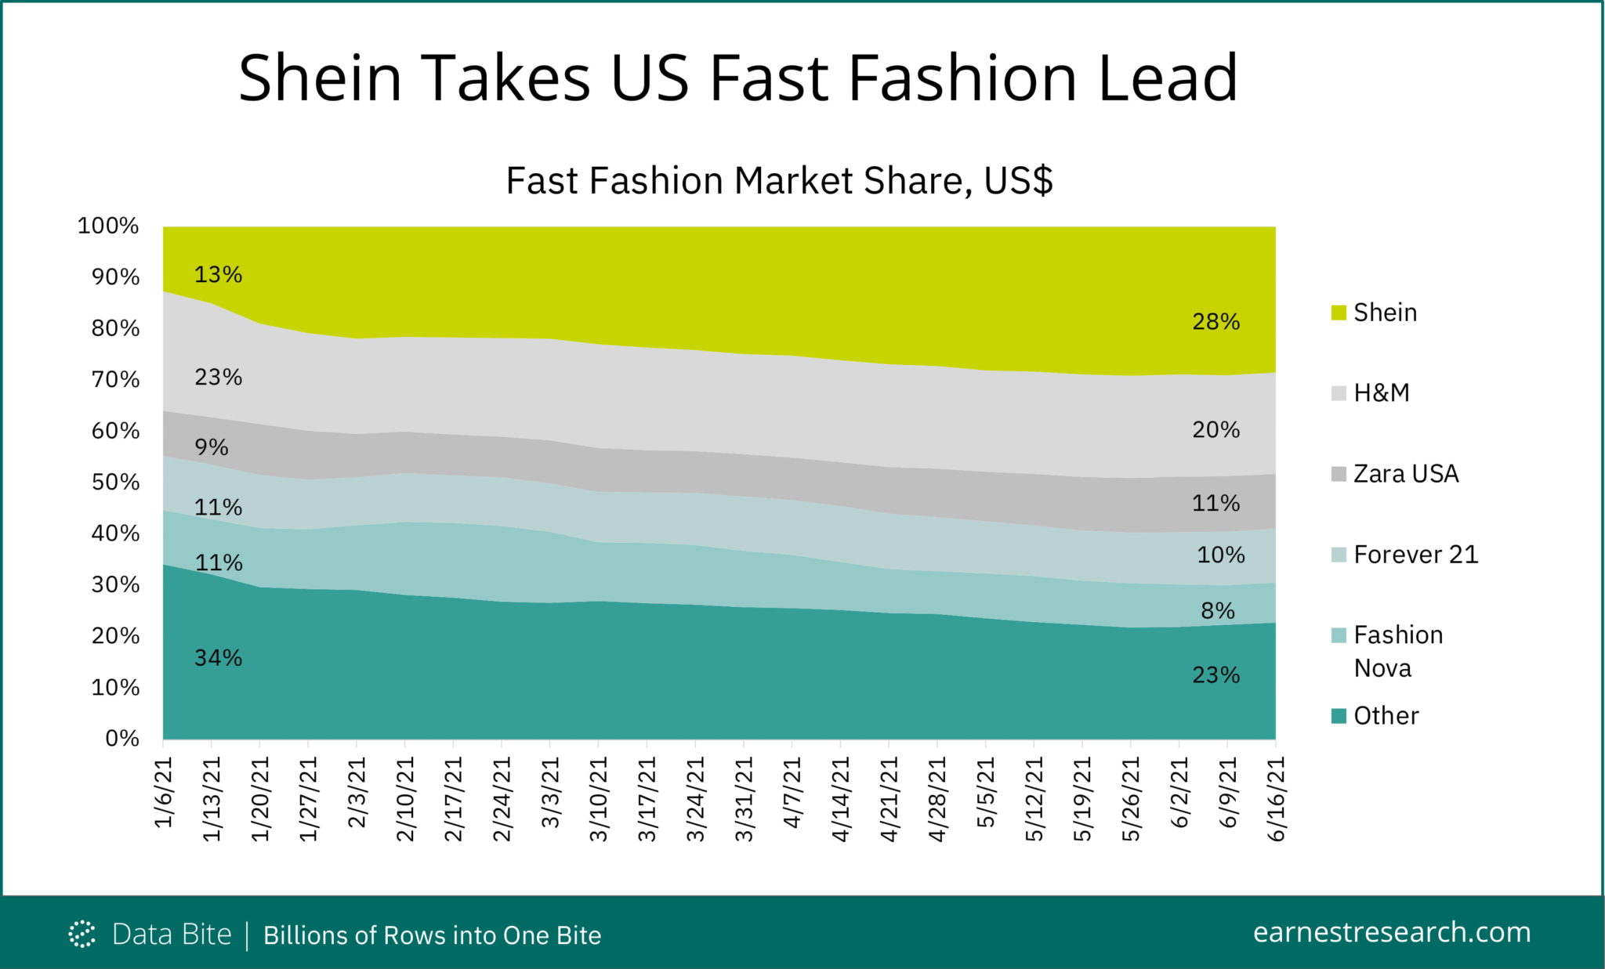
Market Research

Slide 27
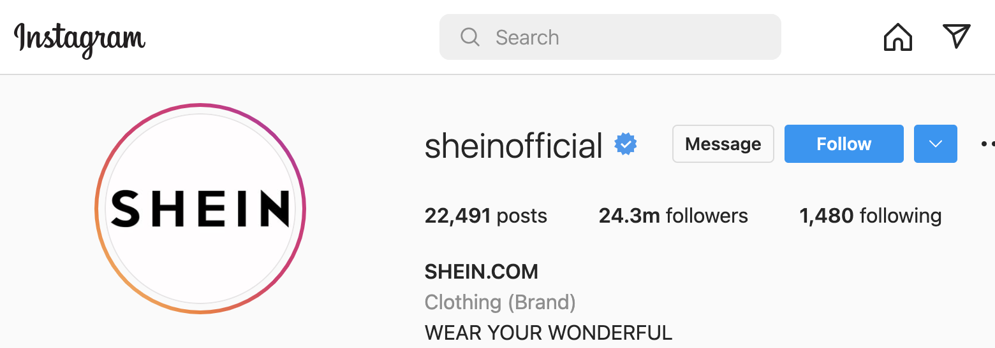
External Analysis - Smart Tactics
Building strong customer relationships
Shein’s aim is to promptly offer stylish quality products at appealing prices to every user in the world.
The organization has used social media platforms like Instagram in a smart way, with close to 24M followers.
Instead of having the top models from the fashion industry on their main page for branding, they collaborate a lot with the general public who purchase their merchandise, and have their “Instagram posts” on the main page, so that the general public can relate with such posts. This is smart tactics.
There are examples where customers themselves have products to sell, who are also loyal customers to Shein. For such a customer base, Shein has helped them advertise their products on their social media platforms, with customer “posts”, wearing Shein outfits, as well as showcasing their own products.
Shein follows 1480 accounts on Instagram, most of which are local small scale businesses, and also general public. This is one of the means, through which they implement the above point.
https://thesocialgrabber.com/marketing-strategy-and-swot-analysis-of-shein/

Slide 28
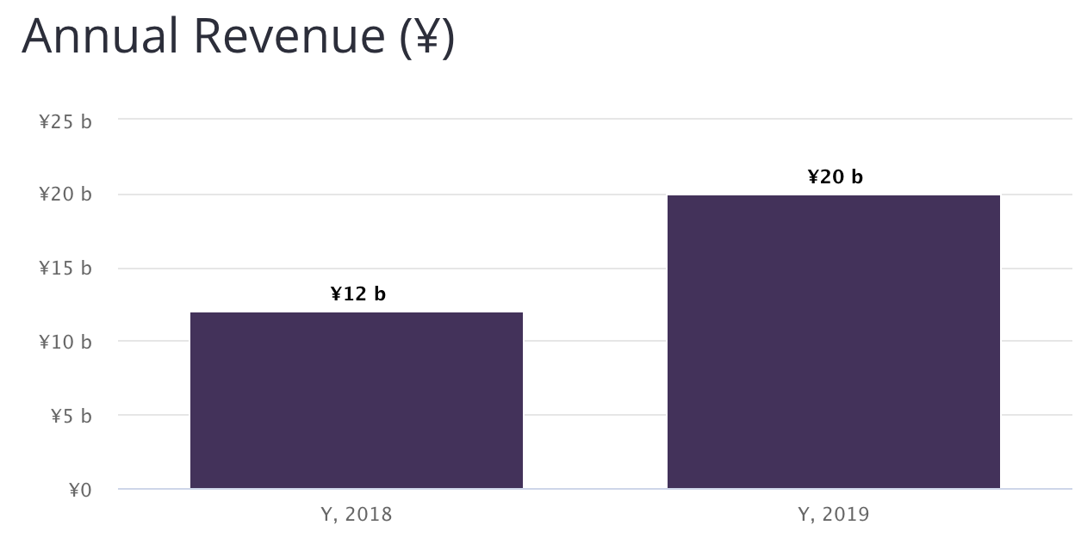
Internal Analysis
Initially, Shein did not design its own clothes. However, it became a fully integrated retailer in 2014 when it secured its own supply chain system.
After Shein’s recent funding round, the company’s valuation is close to a $100B, which is more than the combined worth of H&M, and Zara. [1]
The company hasn’t unveiled any plans for an IPO. [1]
Shein’s C-suite:
Chris Xu - Founder & CEO
Liegh Gui - Chief Financial Officer
Peter Day - Chief Privacy Officer
Leon Li - Chief Security Officer
Shein has made significant use of “U.S. Legislative Bill Section 321 for Trade Facilitation”, which states that any import up to $800 per person is duty-free. This bill has allowed Shein to deliver to the USA without paying taxes, allowing Shein to have a competitive advantage over domestic companies. [2]
[1] https://www.bloomberg.com/news/articles/2022-04-04/shein-s-100-billion-valuation-would-top-h-m-and-zara-combined
[2] https://en.wikipedia.org/wiki/Shein_(company)#cite_note-:0-3

Slide 29
SWOT Analysis for Shein
Strengths
Weaknesses
S
W
Worldwide shopping, covering more than 220 countries
Diverse range of clothing - boho dresses to graphic tees
Competitive prices
Slow delivery - 2 to 3 weeks
Lack of warehouses - causing delivery issues
O
T
Opportunities
Threats
As e-commerce fashion is growing, Shein should bring more brands onboard
Target customers from higher financial classes as well with unique clothing
Data breach
Unpredictable consumer preferences

